Slide 1
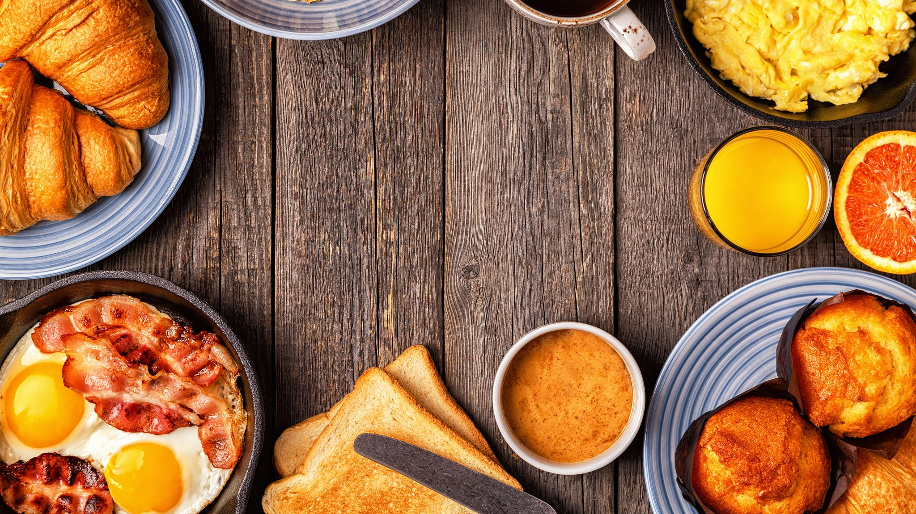
Better Meals
TinyCoders
Kevin Dimayuga, Toussaint Gilbert, Johnnae Brown

Slide 2
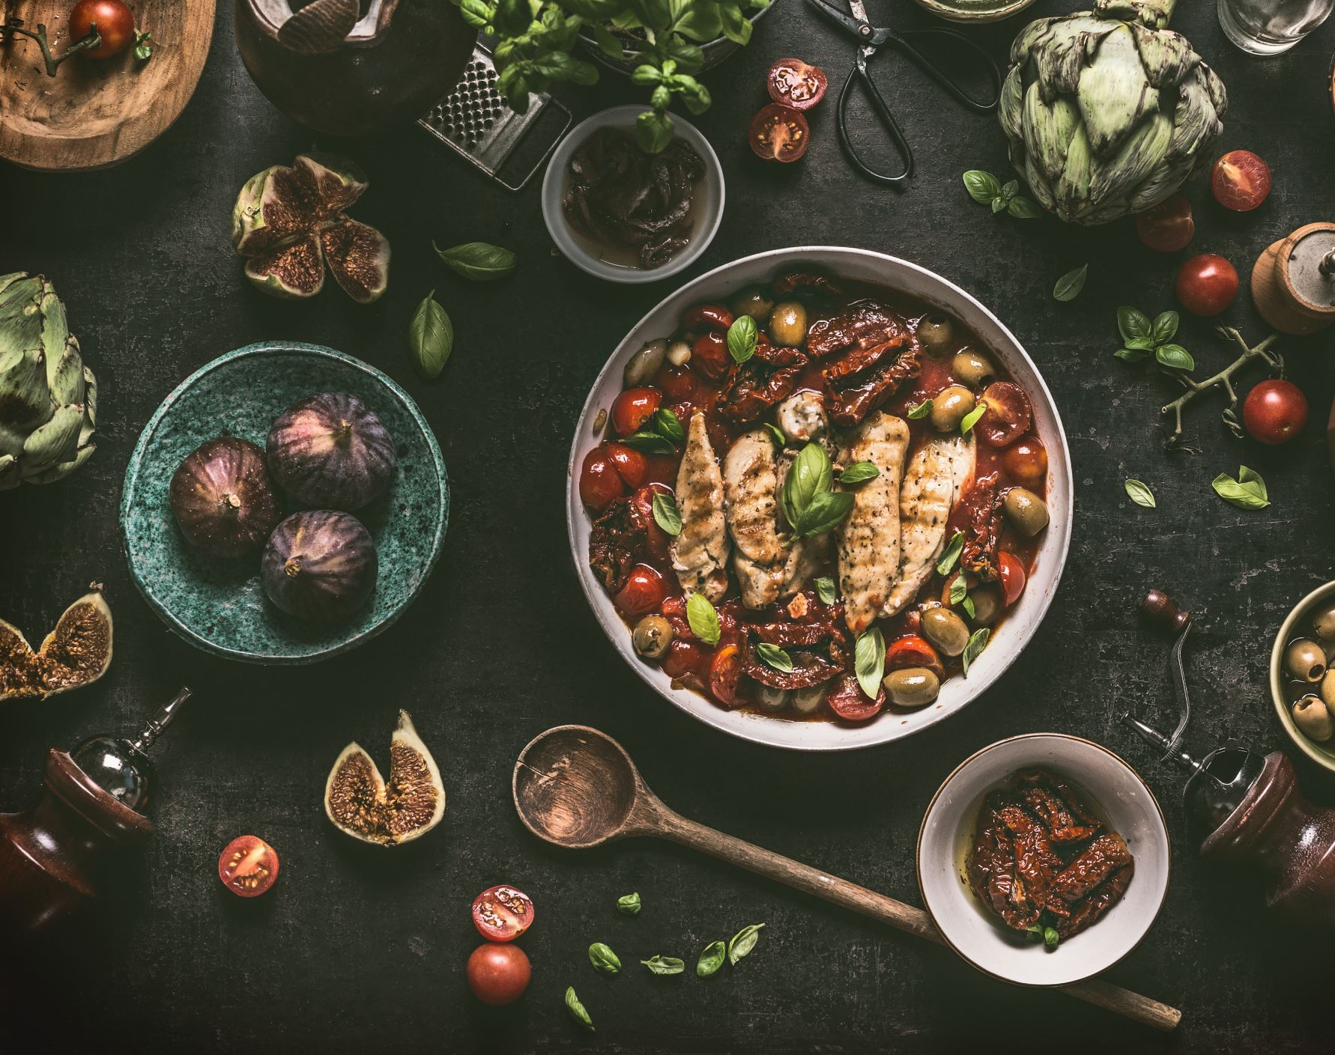
For everyday people that value nutrient dense meals and are ready to expand their food horizons. Better Meals is the start.

Slide 3
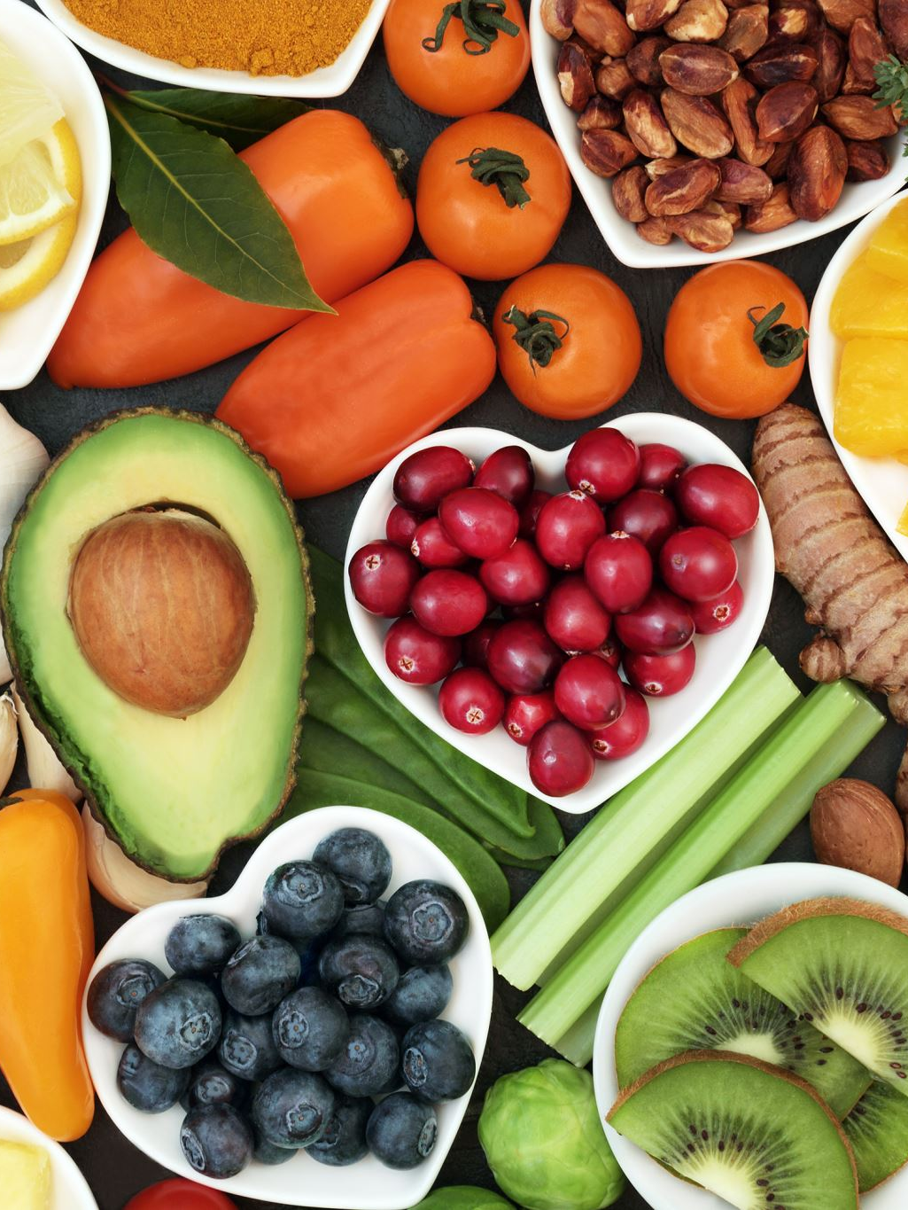
This app is for people that want healthier options for meals
Often people want healthy meals but find them boring or lacking flavor. With Better Meals you will be able to input ingredients and a plethora of meal options and nutrition facts will appear then, you can choose which meal works best for you.
AS A user
I WANT to use this food web application
SO THAT I can create a nutritionally-balanced meal

Slide 4
This project was truly a group effort. Kevin worked java script, Toussaint html and CSS and Brown quarterbacked helping wherever needed. Our biggest hurdle was API the whole group got locked out, as much help as we reached out for the subject never got any easier.
HTML, CSS, JavaScript
Nutritionix API and Edamam API
Git merging and branches were difficult as well

Slide 5
Demo
https://ToussaintG1.github.io/better-meals/

Slide 6
Future Development
Add other sections when user searches
Recipe image
Utilize different query parameters
Mealtype (breakfast, lunch dinner)
Calories (range of calories)
Diet (balanced, high-protein, low-carb)
Make localStorage better
Rather than them typing it in themselves to the localStorage section, have a 'save' button and have it pinned as the user scrolls which makes it more user-friendly
API for where to purchase these recipes/ingredients
Amazon Fresh (hypothetical example)
User Review sections for recipes

Slide 7
Deployed Webpage and GitHub Repo
https://toussaintg1.github.io/better-meals/#nutritional-facts
https://github.com/ToussaintG1/better-meals

